Slide 1







Machine learning Model for performance prediction
Stimulating innovation through collaboration

Slide 2

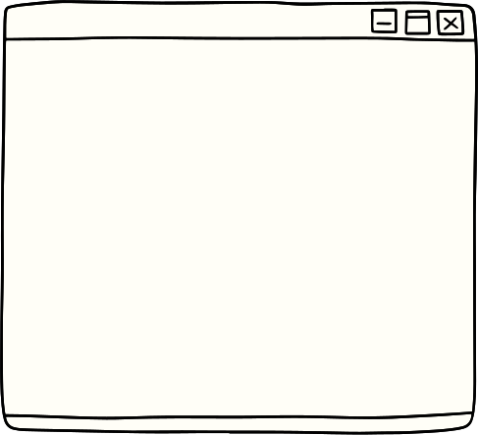



Introduction
We will be building machine learning models to predict the employee performance based on the model accuracy.
We will be first performing EDA over the dataset to ensure there is no null values are present.

Slide 3





Models
Scaling Methods
Models
will use three different models to predict and will check the accuracy.
Standard Scaler
Min Max Scaler
01
XGBOOST we will use the XGBOOST model to predict the dependent variable and check for the accuracy using the model
02
CATBOOST we will use the CATBOOST model to predict the dependent variable and check for the accuracy using the model
Robust
Scaler
MaxABS
Scaler
03
LightGBM we will use the LightGBM model to predict the dependent variable and check for the accuracy using the model

Slide 4

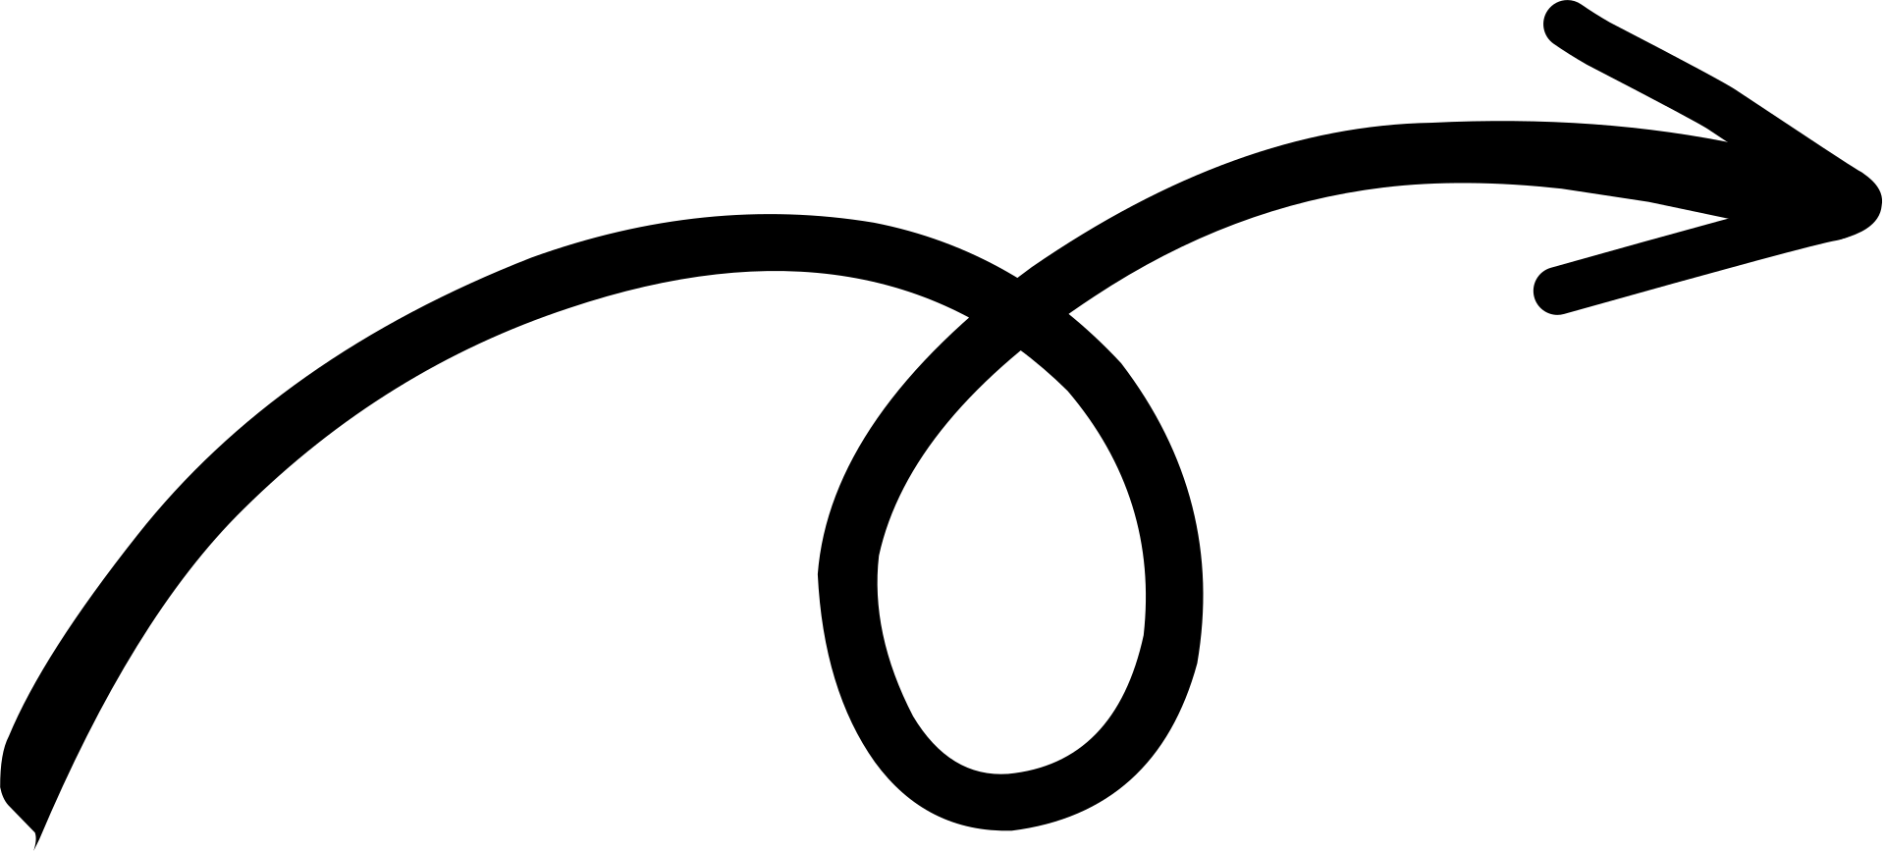
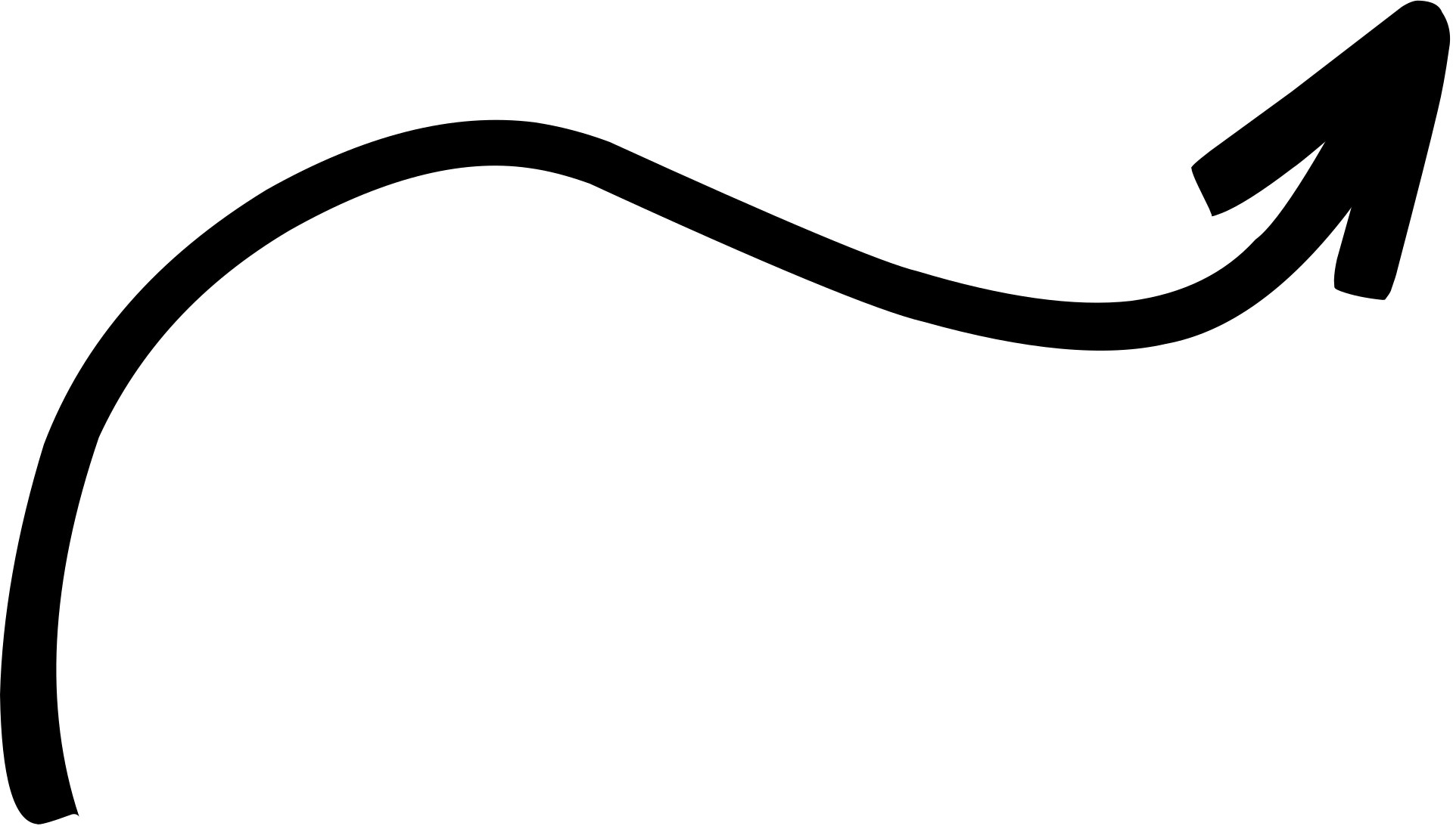



Models and their performance
XGBoost
Cat Boost
LightGBM
XG Boost model has given us different accuracy with different scaling method.
Accuracy with standard scaler is 91%.
Accuracy with Min_Max scaler is 92%.
Accuracy with Robust scaler is 90%
Accuracy with Max abs scaler is 92%
Cat Boost model has given us different accuracy with different scaling method.
Accuracy with standard scaler is 91%.
Accuracy with Min_Max scaler is 94%.
Accuracy with Robust scaler is 94%
Accuracy with Max abs scaler is 94%
Cat Boost model has given us different accuracy with different scaling method.
Accuracy with standard scaler is 91%.
Accuracy with Min_Max scaler is 91%.
Accuracy with Robust scaler is 87%
Accuracy with Max abs scaler is 90%

Slide 5

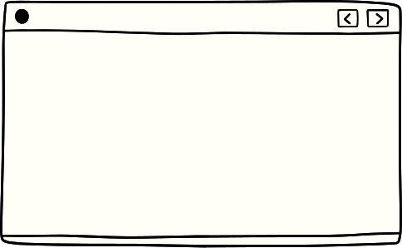


Conclusion
We will choose cat boost model for my prediction as we can see after iterating over all the scaling method. We are getting better accuracy with Cat Boost machine learning model

